Slide 1

ADVANCED FACIAL RECOGNITION ATTENDANCE SYSTEM
Project Supervisor: Dr. M. MAHESWARI, M.E., Ph.D.,
Name of the Student: Mr. ARIKATLA GOPI VENKATA SUDHEER
Register Number: 38110046

Slide 2
Presentation Outline
Course Certificate
Introduction
Objectives
System Architecture / Ideation Map
Module Implementation
Application Snapshots
Results and Discussions
Conclusion & Future work
References

Slide 3
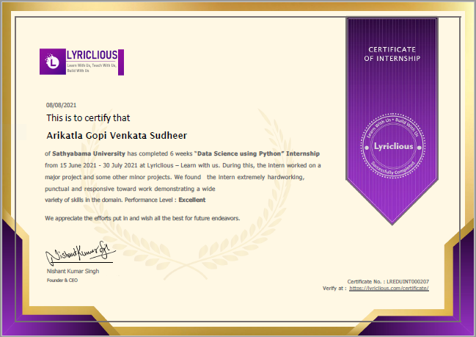
Course Certificate

Slide 4
Introduction
According to the previous attendance management system, the accuracy of the data collected is the biggest issue. This is because the attendance might not be recorded personally by the original person, in another word, the attendance of a particular person can be taken by a third party without the realization of the institution which violates the accuracy of the data.
For example, student A is lazy to attend a particular class, so student B helped him/her to sign for the attendance which in fact student A didn’t attend the class, but the system overlooked this matter due to no enforcement practiced.

Slide 5
Introduction
Supposing the institution establish an enforcement, it might need to waste a lot of human resource and time which in turn will not be practical at all.
Thus, all the recorded attendance in the previous system is not reliable for analysis usage.
The second problem of the previous system is where it is too time consuming.
Assuming the time taken for a student to sign his/her attendance on a 3-4 paged name list is approximately 1 minute. In 1 hour, only approximately 60 students can sign their attendance which is obviously inefficient and time consuming.

Slide 6
Objectives
▪ To develop a portable Smart Attendance System which is handy and self-powered.
▪ To ensure the speed of the attendance recording process is faster than the previous system which can go as fast as approximately 3 second for each student.
▪ Have enough memory space to store the database.
▪Able to recognize the face of an individual accurately based on the face database.

Slide 7
Objectives
▪ Allow parents to track their child‟s attendance.
▪ Develop a database for the attendance management system.
▪ Provide a user-friendly interface for admins to access the attendance database andfor non-admins (parents) to check their child‟s attendance by mailing the attendance.
▪ Allow new students or staff to store their faces in the database by using a GUI.
▪ Able to show an indication to the user whether the face- recognition process is successful or not.

Slide 8
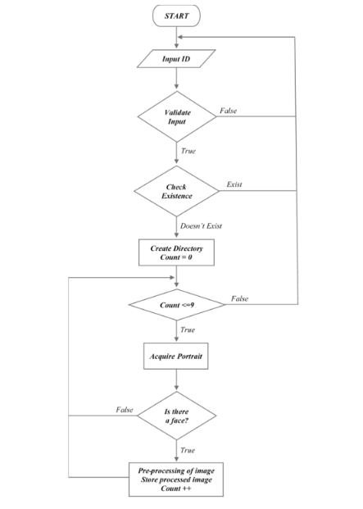
System Architecture / Ideation Map

Slide 9
Project Implementation
Attendance System Using NFC Technology with Embedded Camera on Mobile Device
According to research journal “Attendance System Using NFC (Near Field Communication) Technology with Embedded Camera on Mobile Device” (Bhise, Khichi, Korde,Lokare, 2015).
The attendance system is improved by using NFCtechnology and mobile application. According to the research paper, each student is given a NFC tag that has a unique ID during their enrolment into the college. Attendance of each class will then be taken by touching or moving these tags on the lecturer mobile phone.
The embedded camera on the phone will then capture the student‟s face to send all the data to the college server to do validation and verification. The advantages of this method is where the NFC is simple to use, and the speed of connection establishment is very high. It indeed speeds up the attendance taking process a lot.

Slide 10
Project Implementation
OpenCV
OpenCV (Open source computer vision) is a library of programming functions mainly aimed at real-time computer vision.
The OpenCV project was initially an Intel Research initiative to advance CPU-intensive applications, part of a series of projects including real-time raytracing and 3Ddisplay walls. The main contributors to the project included several optimization experts in Intel Russia, as well as Intel's Performance Library Team.

Slide 11
Project Implementation
NumPy”
NumPy is a package that defines a multi-dimensional array object and associated fast math functions that operate on it. It also provides simple routines for linear algebra and fft and sophisticated random-number generation. NumPy replaces both Numeric and Numarray.
The numpy namespace includes all names under the numpy.core and numpy.lib namespaces as well. Thus, import numpy will also import the names from numpy.core and numpy.lib. This is the recommended way to use numpy.

Slide 12
Project Implementation
Hardware Development
Camera Module with good mega pixels.
Power Supply Cable
16Gb Micro SD Card Class 10
SOFTWARE REQUIREMENT
PYTHON 3.6
IDE(SPYDER)
OPENCV
NUMPY

Slide 13
Methodology
Before the attendance management system can work, there are a set of data needed to be inputted into the system which essentially consist of the individual‟s basic information which is their ID and their faces.
The first procedure of portrait acquisition can be done by using the Camera to capture the faces of the individual.
In this process the system will first detect the presence of a face in the captured image, if there are no face detected, the system will prompt the user to capture their face again until it meets certain number of portraits which will be 10 required portraits in this project for each student

Slide 14
Methodology
. The decision of storing only 10 portrait per student is due to the consideration of the limited storage space in the raspberry pi because the total amount of students in the university is considered heavy.
Then, the images will undergo several pre-processing procedures to obtain a grayscale image and cropped faces of equal sized images because those are the prerequisites of using the EigenFaces Recognizer.
Both of the processes mentioned above can be represented in the diagram below

Slide 15
Results and Discussion
The result of this program is an application that enhances the user to store the attendance of their students.
Advanced Facial Recognition Attendance System is a technological opportunity for the school, college, university and coaching centre institutions searching for a secure, simple and alternative solution to the conventional paper-based exam results evaluation, reporting and distribution.

Slide 16
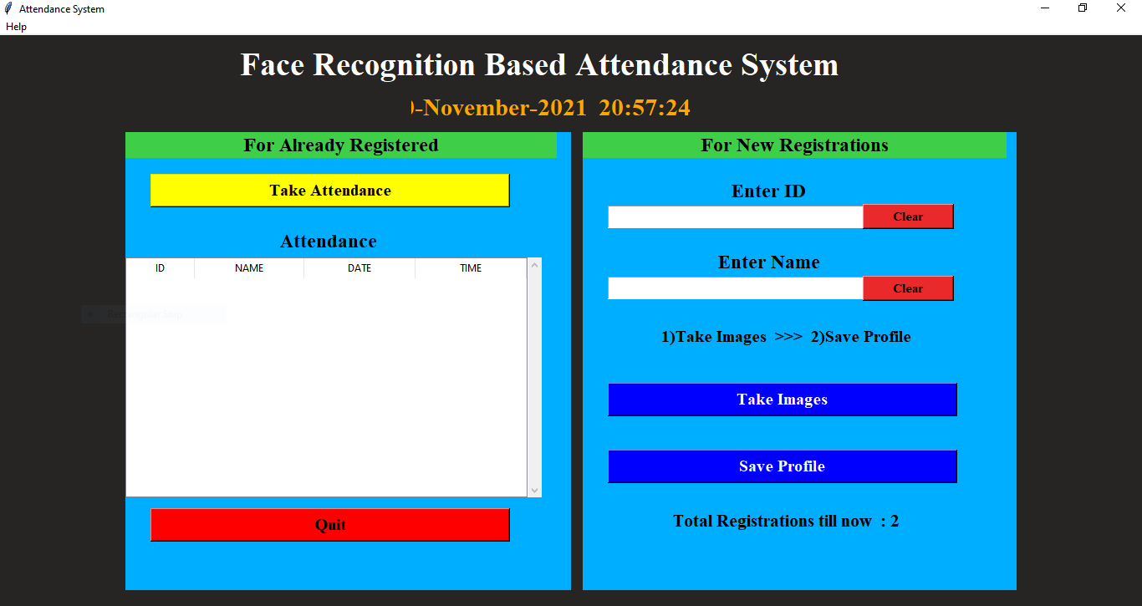
Results and Discussion
FIG 4.1.1 ATTENDANCE SYSTEM

Slide 17
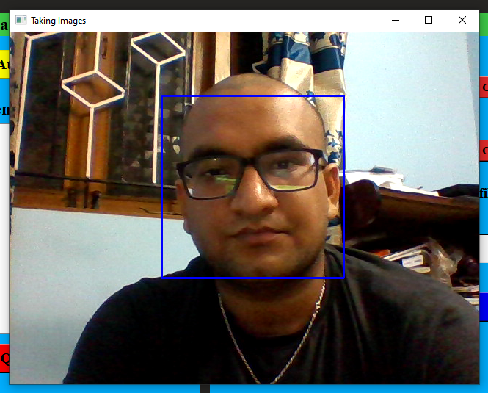
Results and Discussion
FIG 4.1.2 TAKING IMAGES FOR DATA SET

Slide 18
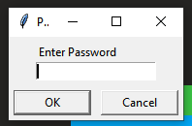
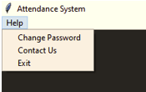
Results and Discussion
FIG 4.1.3 ENTER PASSWORD TO SAVE STUDENT PROFILE
FIG 4.1.4 HELP MENU

Slide 19
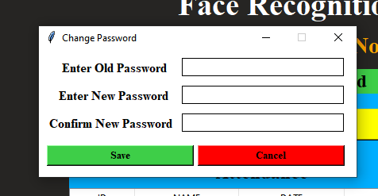
Results and Discussion
FIG 4.1.5 CHANGE PASSWORD

Slide 20
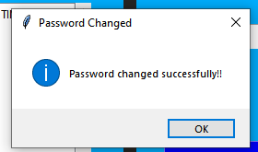
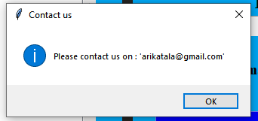
Results and Discussion
FIG 4.1.6 PASSWORD CHANGED
FIG 4.1.7 CONTACT US

Slide 21
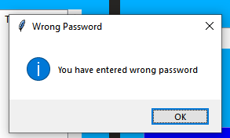
Results and Discussion
FIG 4.1.8 PASSWOD ERROR

Slide 22
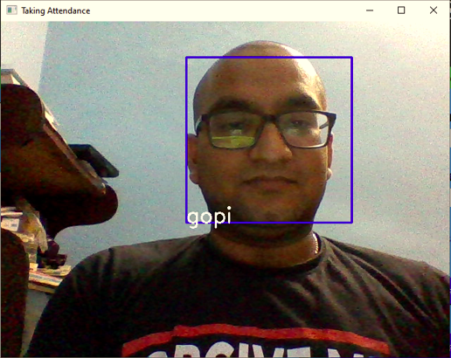
Results and Discussion
FIG 4.1.9 TAKING ATTENDANCE

Slide 23
Conclusion
Before the development of this project. There are many loopholes in the process of taking attendance using the old method which caused many troubles to most of the institutions.
Therefore, the facial recognition feature embedded in the attendance monitoring system can not only ensure attendance to be taken accurately and also eliminated the flaws in the previous system.

Slide 24
Conclusion
By using technology to conquer the defects cannot merely save resources but also reduces human intervention in the whole process by handling all the complicated task to the machine. The only cost to this solution is to have sufficient space in to store all the faces into the database storage.

Slide 25
Conclusion
Fortunately, there is such existence of micro SD that can compensate with the volume of the data. In this project, the face database is successfully built. Apart from that, the face recognizing system is also working well.
At the end, the system not only resolve troubles that exist in the old model but also provide convenience to the user to access the information collected by mailing the attendance sheet to the respected faculty.

Slide 26
References
[1]. “Attendance System Using NFC Technology with Embedded Camera on Mobile Device” (Bhise, Khichi, Korde,Lokare, 2015)
[2]. K.SenthamilSelvi, P.Chitrakala, A.AntonyJenitha, "Face Recognition Based Attendance Marking System", IJCSMC, Vol. 3, Issue. 2, February 2014.
[3]. “Fingerprint Based Attendance System Using Microcontroller and LabView” (Kumar Yadav, Singh, Pujari, Mishra, 2015)
[4]. “RFID based Student Attendance System” (Hussain, Dugar, Deka, Hannan, 2014)
[5]. OpenCv Documentation -https://opencv.org
[6]. Numpy - https://numpy.org

Slide 27
THE END
THANK YOU

